Slide 1
E-Safety

Slide 2
What are we doing here?
Share results of survey and feedback
Explain what we learn in school
Discuss hints and tips at home
Have a go at setting privacy settings
Know where to go on the internet for help

Slide 3
VIDEO
https://www.internetmatters.org/safer-internet-day-2018/

Slide 4
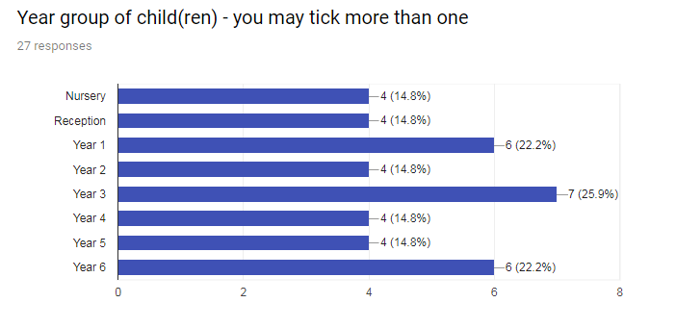
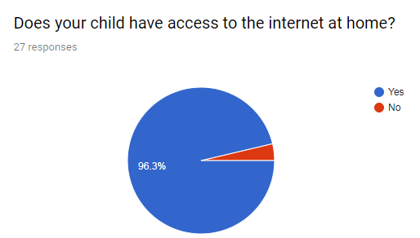
What the survey said

Slide 5
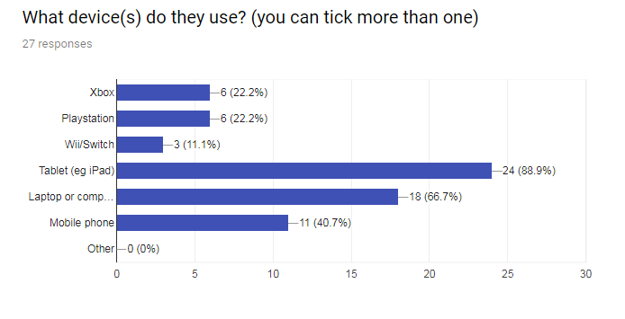

Slide 6
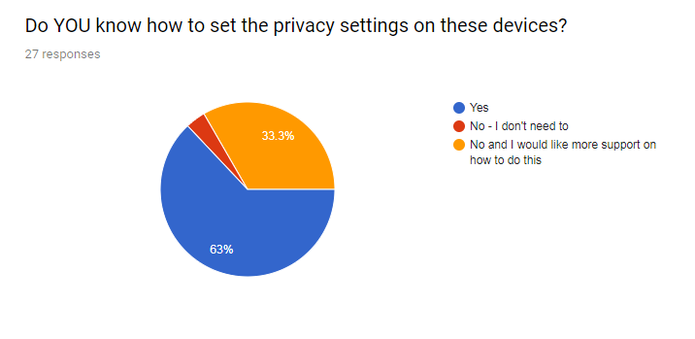

Slide 7
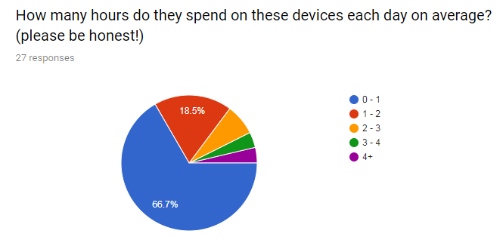

Slide 8
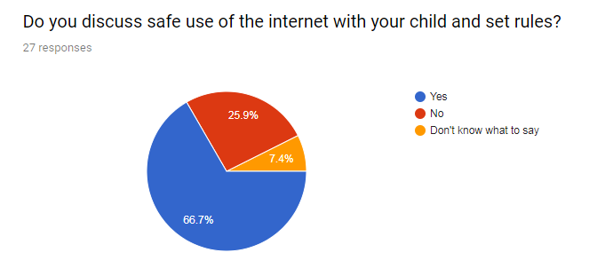

Slide 9
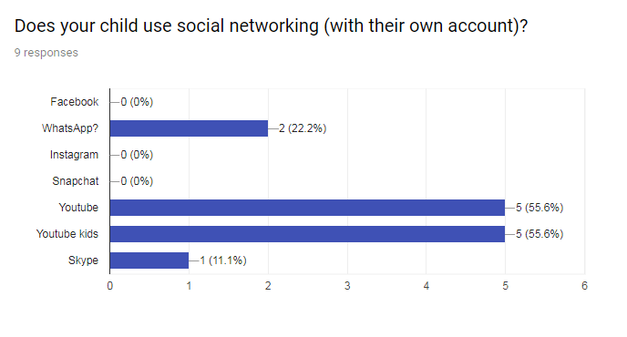

Slide 10
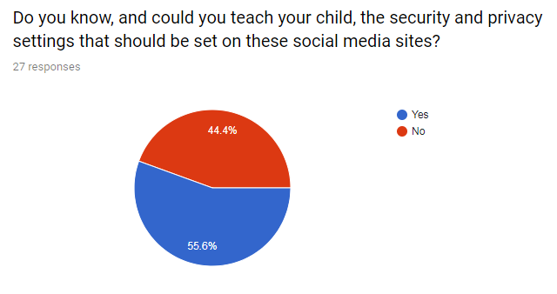

Slide 11
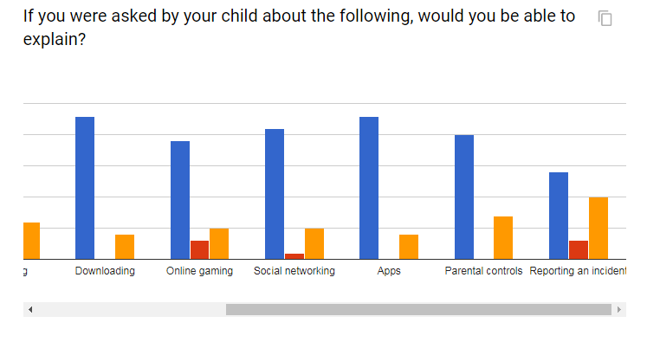

Slide 12
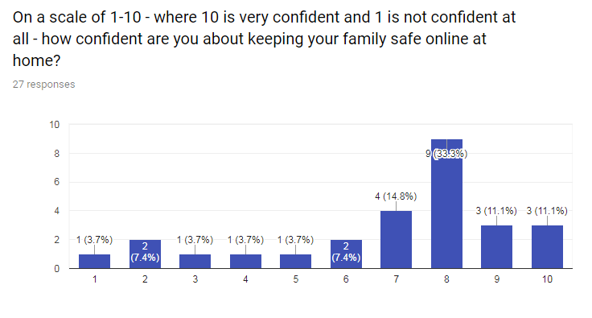

Slide 13
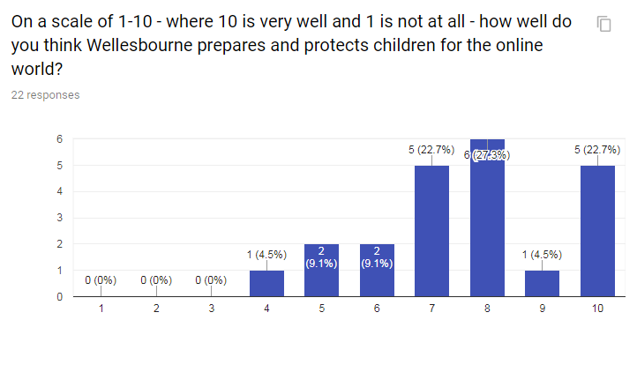

Slide 14
What do we teach in school…
ICT skills
Computing skills
E-safety

Slide 15
Information technology
How to use programs such as Word, PowerPoint, Excel and Publisher are taught through different lesson such as science, English, maths and within computing itself.

Slide 16

Computer Science
It’s all about using computational thinking to solve problems and making things for a purpose.
We create computer games, look at bugs within scripts and how to fix them, design buildings and programme toys to follow a set route.

Slide 17
E-safety
In the computing curriculum it is part of digital literacy- how to use technology safely and responsibly.
Discrete lessons are taught at the beginning of each term.
Within every computing lesson where there is an e-safety link, we alert children to it and remind them how to be safe and responsible.
Internet Safer Day is in February every year which we celebrate by doing different activities throughout the week to the theme of that year. This year it is Create, Connect and Share Respect.

Slide 18
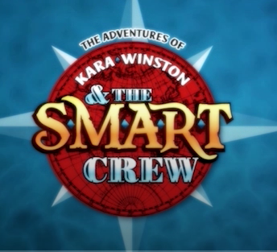
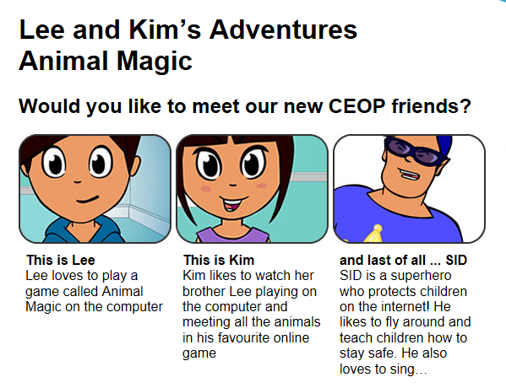
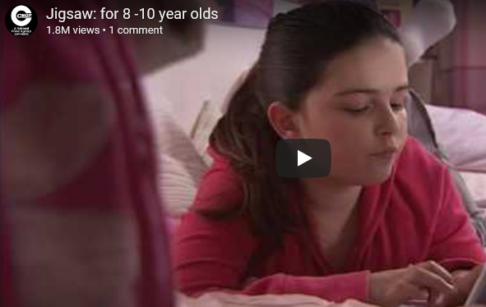

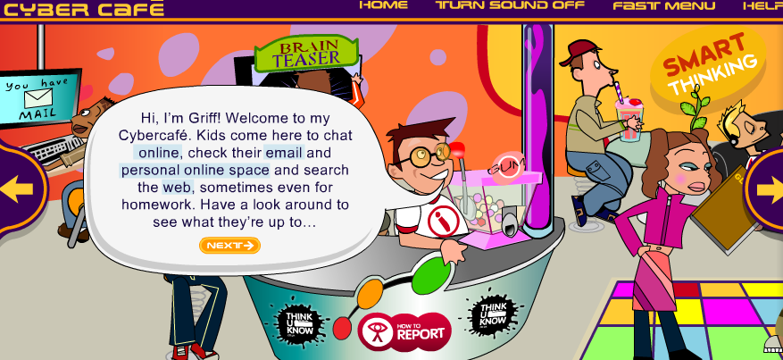
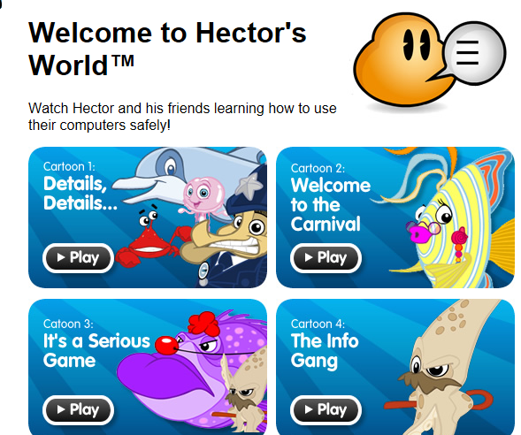
E-safety activities

Slide 19


Slide 20
HOW WE PROTECT YOUR CHILDREN
Firewall – strong filtering system
Monitoring – human element to the system that records everything at school
SMART e-safety in every lesson
Report buttons on websites – dolphin/
Regular reviews of our e-safety with governors
INSET with staff to help them keep up to date
E-safety committee – including parents, children, staff members and governors.
Our website and supporting parents

Slide 21
Keeping children safe – Top tips
Agree boundaries and know age limits
Explore together
Put yourself in control – parental controls
Use airplane mode
Stay involved – public place
Talk to siblings – especially older ones
Search safely – use swiggle or kids-search
Don’t let them take phones to their rooms/turn wifi off for them at night

Slide 22
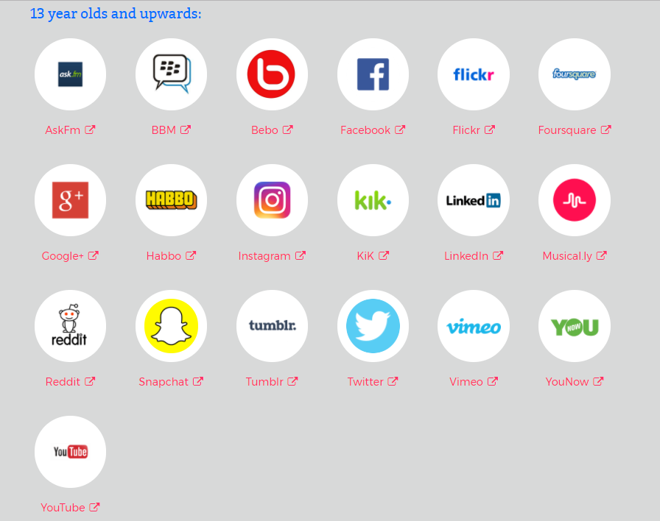
Social media

Slide 23
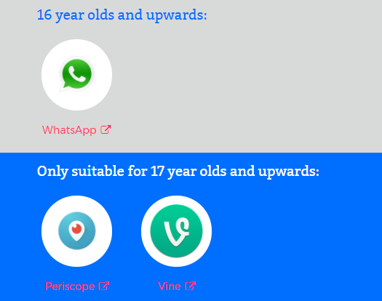

Slide 24
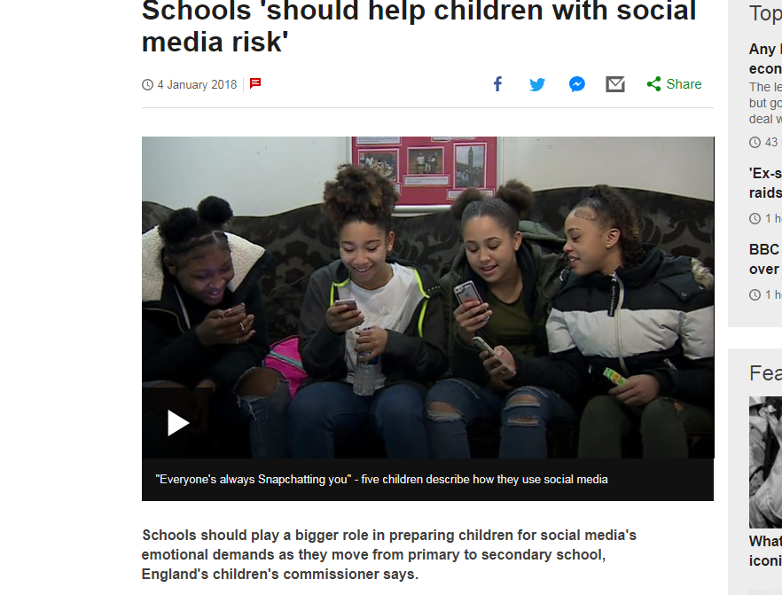
News – year 6 to year 7

Slide 25
Privacy settings – most requested!
Why do we need to set privacy settings?
Conduct – children at risk from own behaviour
Content – inappropriate or unreliable
Contact – children can be contacted by bullies or people that want to groom them or seek to abuse them
Commercialism – children unware of hidden costs or advertising

Slide 26
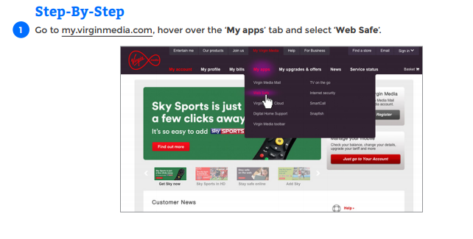
Broadband/internet – Virgin media

Slide 27
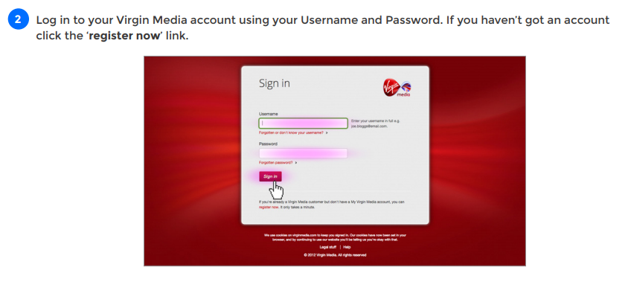

Slide 28
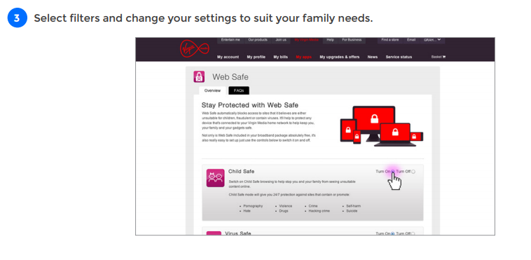

Slide 29
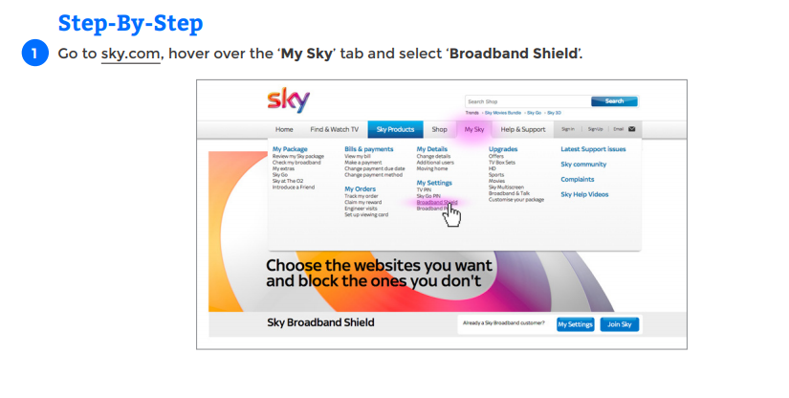
Sky

Slide 30
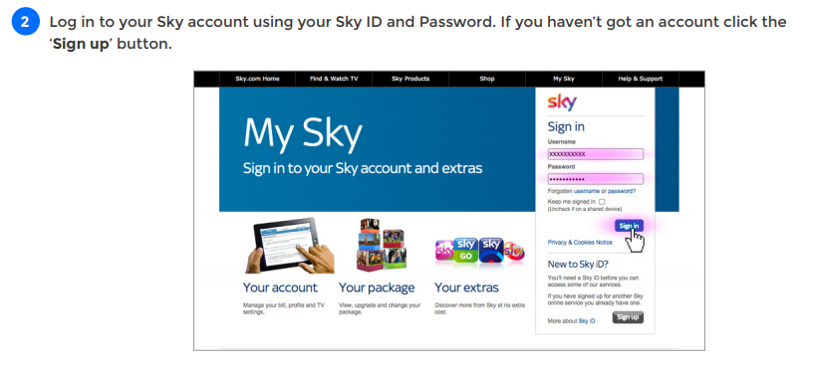

Slide 31
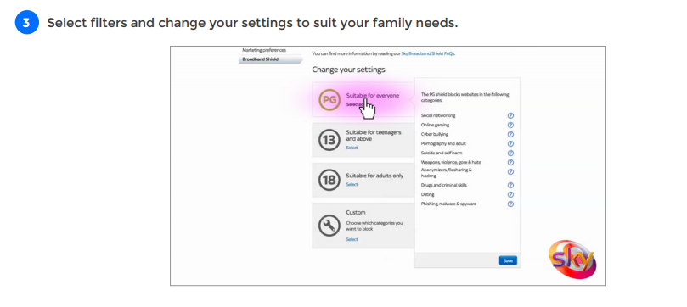

Slide 32
Android
Android items do not let you set privacy on the device.
You need to go into Play Store and select settings here by turning parental controls on.

Slide 33
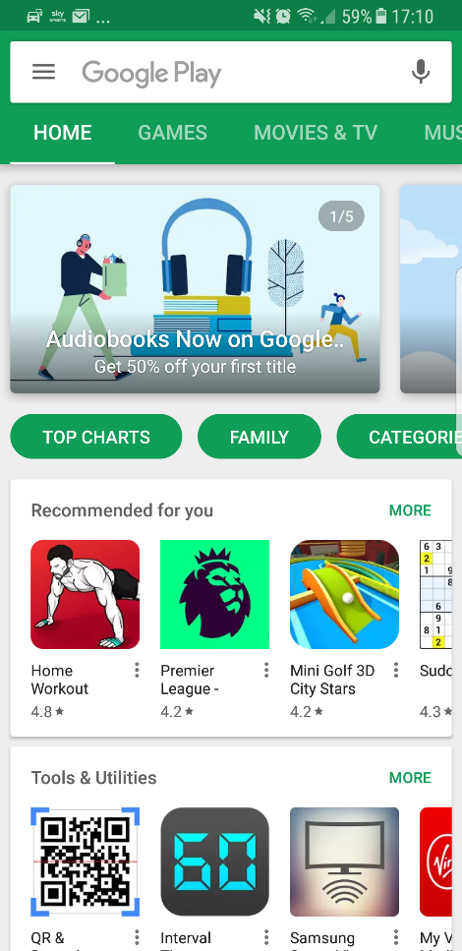
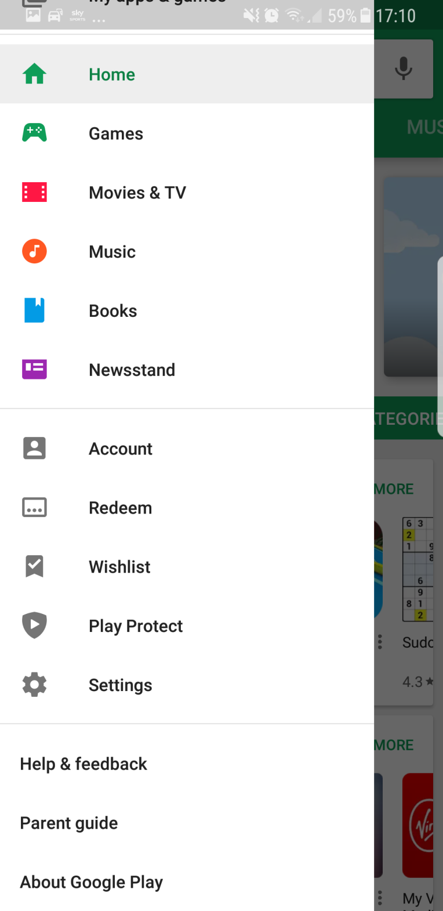
Load up Play Store and click the menu tab.
2. Select settings

Slide 34
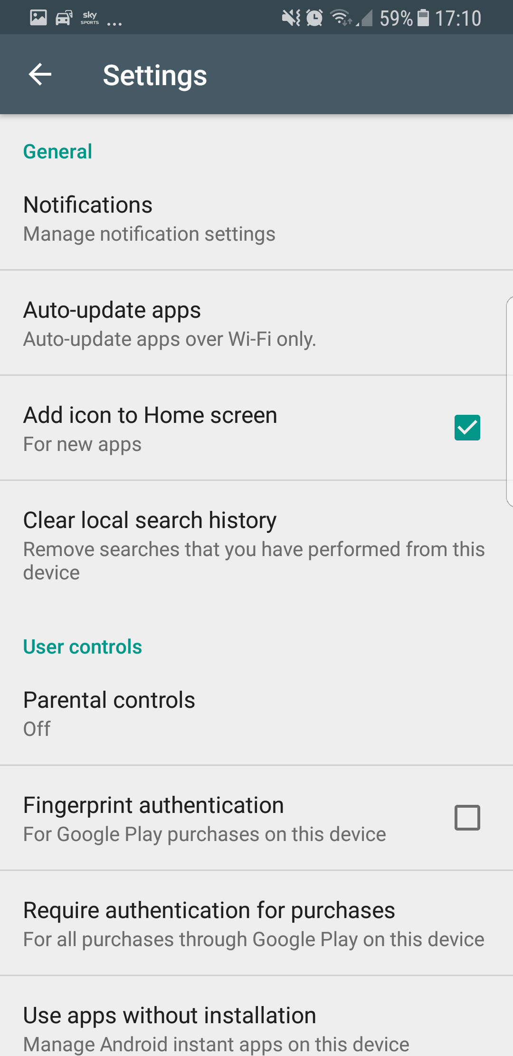
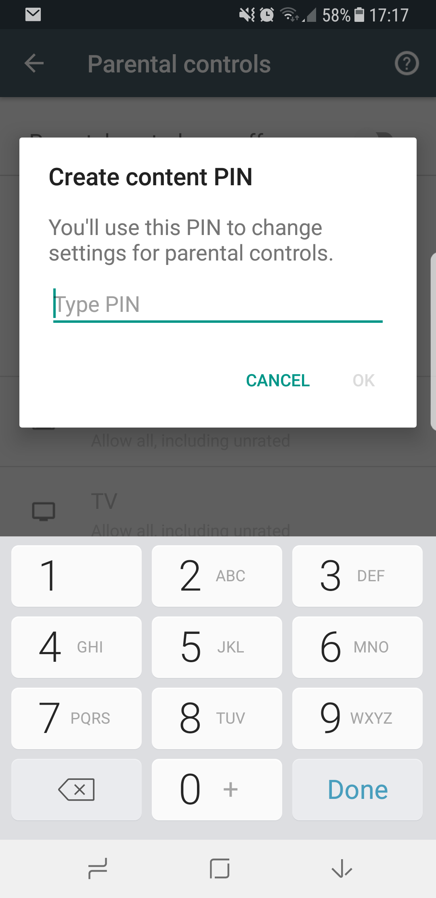
3.) Select ‘Parental Controls’
4.) Enter a pin for only you!

Slide 35
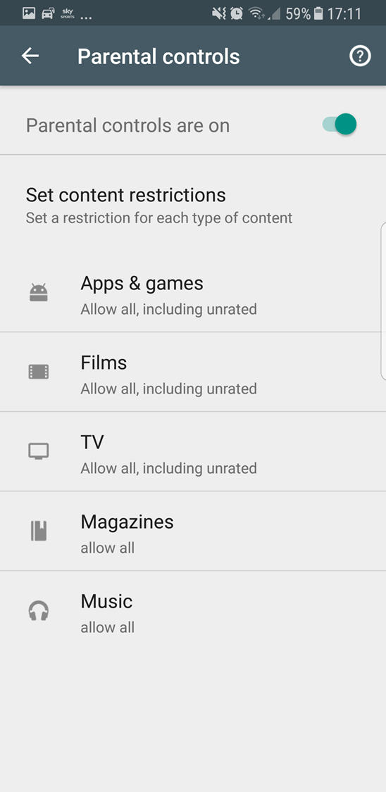
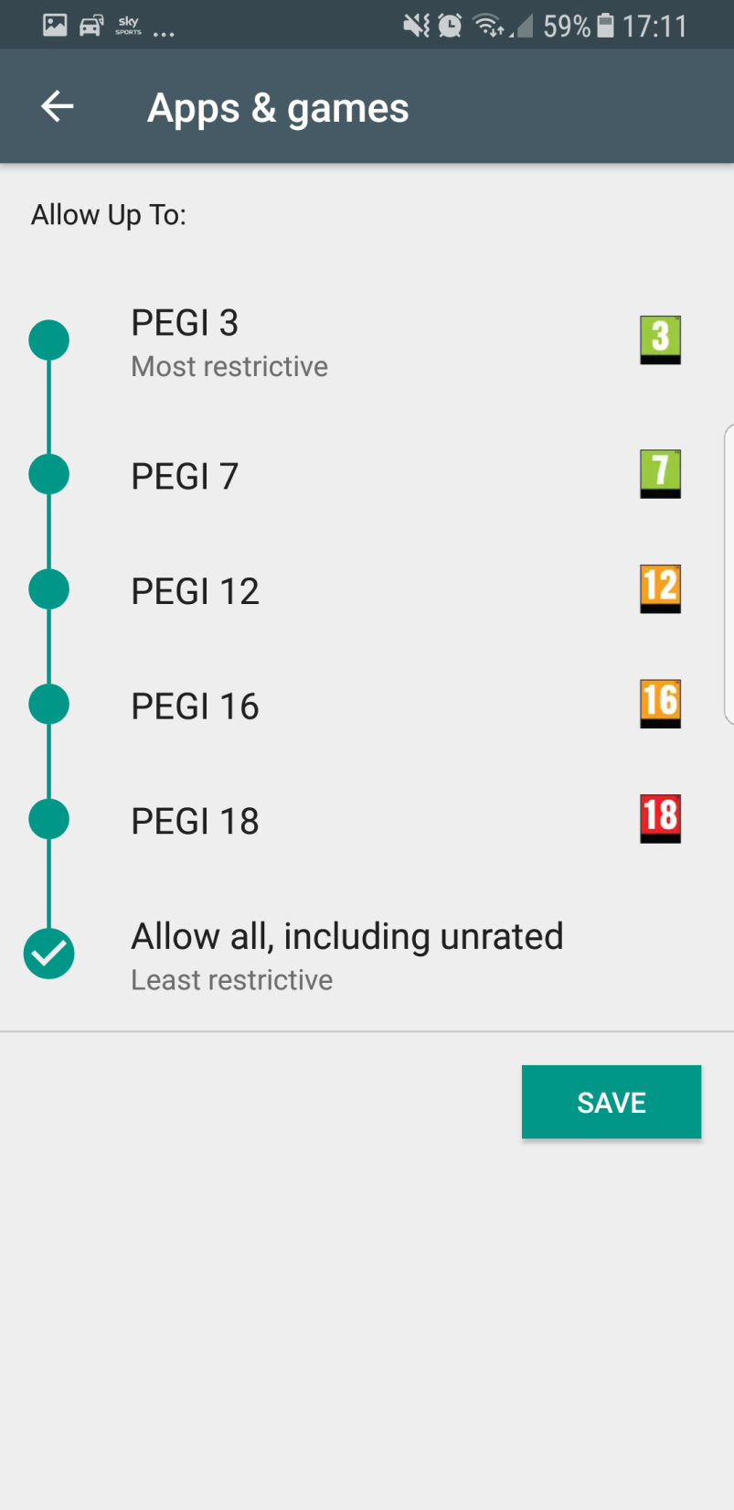
6.) Select an age range for your child.
7.) Then click save
5.) Turn on parental controls

Slide 36
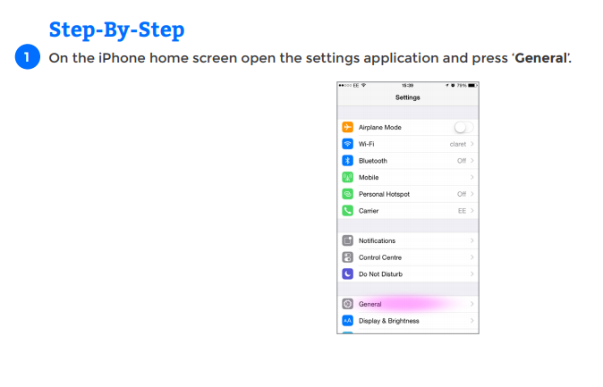
Ios (apple)

Slide 37
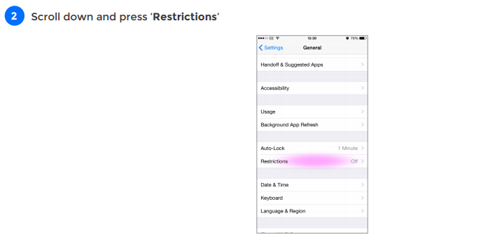

Slide 38
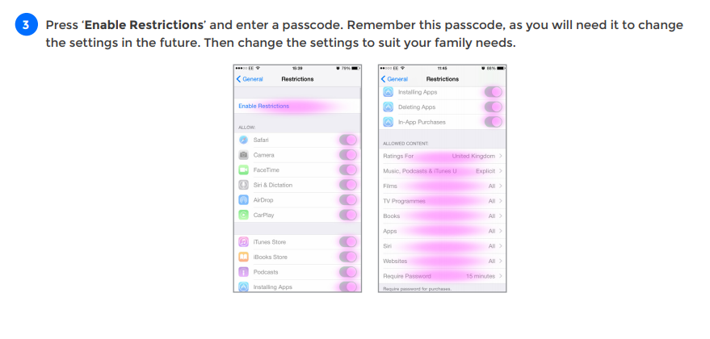

Slide 39
Facebook – 13+
This is a platform that allows messaging, picture sharing and comments to be made.
Over 66% of grooming occurs on Facebook, Instagram and Snapchat
Facebook has a ‘privacy check up tool’ – this shows who can see what
It also has a parents portal

Slide 40

InSTagram

Slide 41
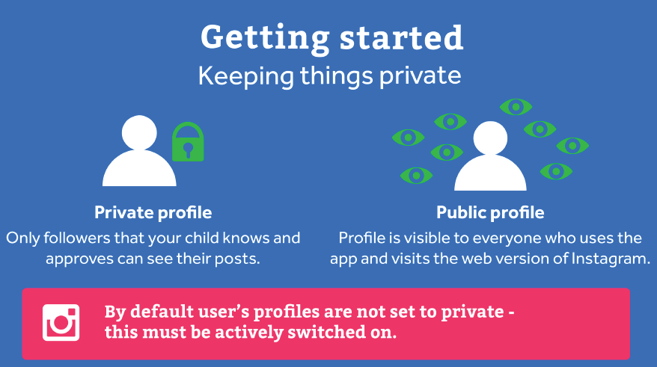

Slide 42
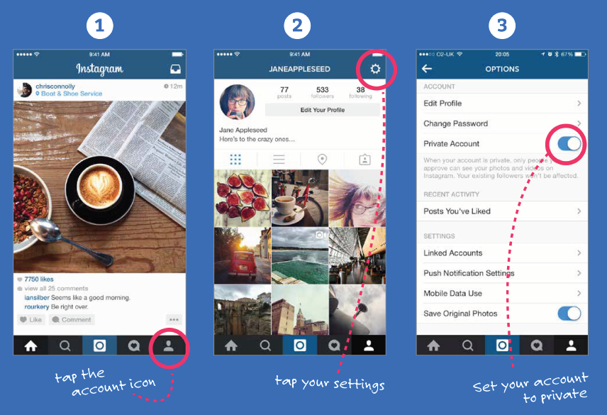

Slide 43
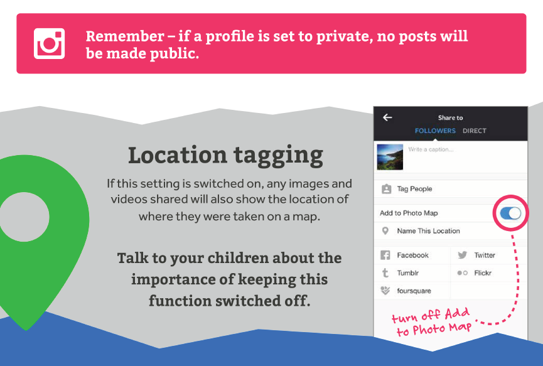

Slide 44
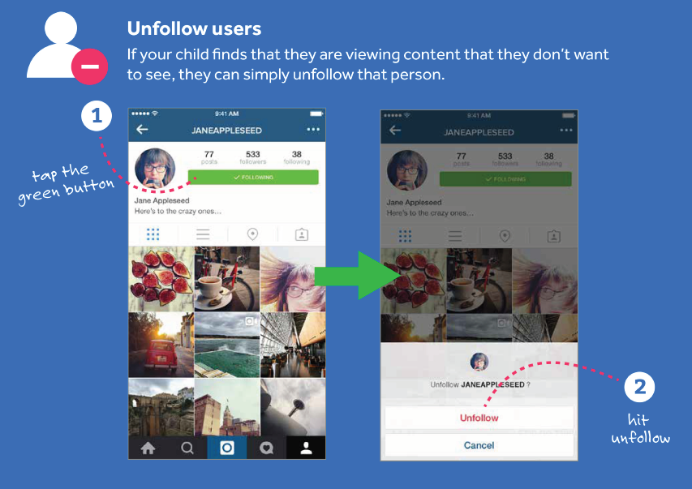

Slide 45
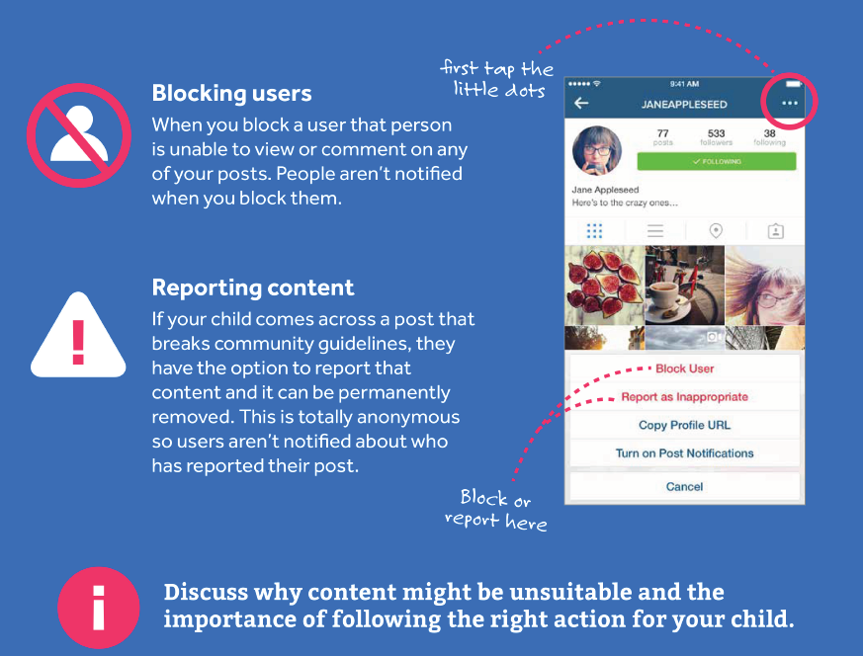

Slide 46
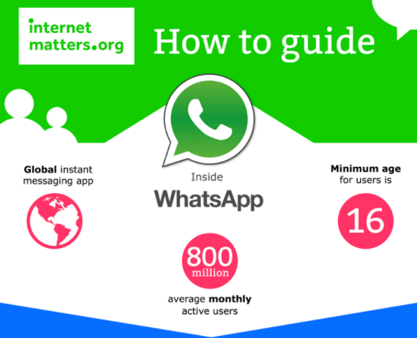
Whatsapp?

Slide 47
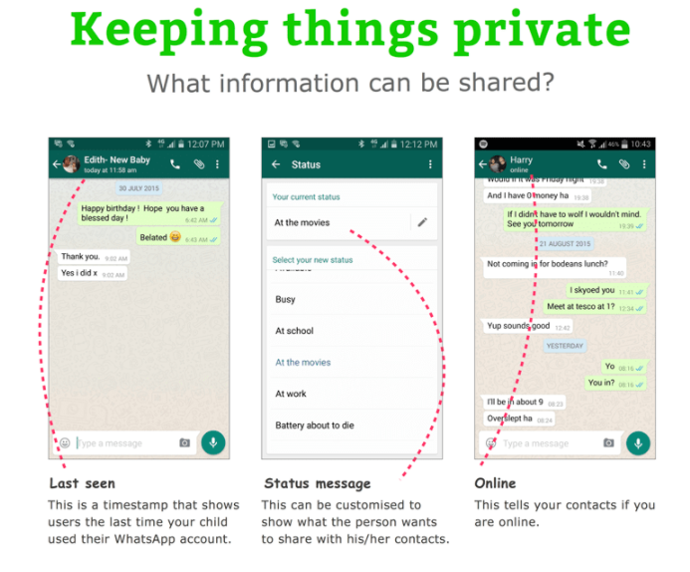
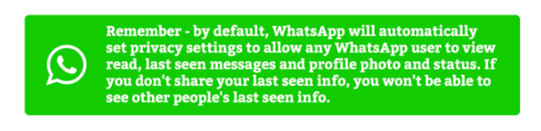

Slide 48
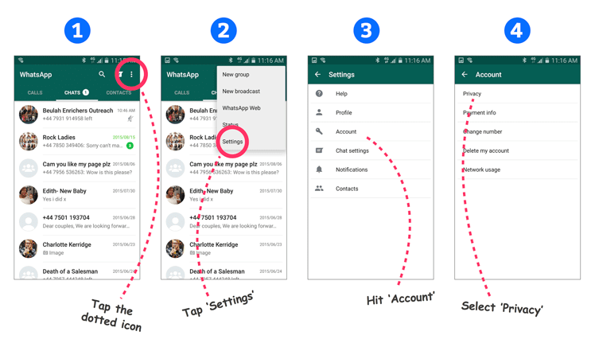

Slide 49
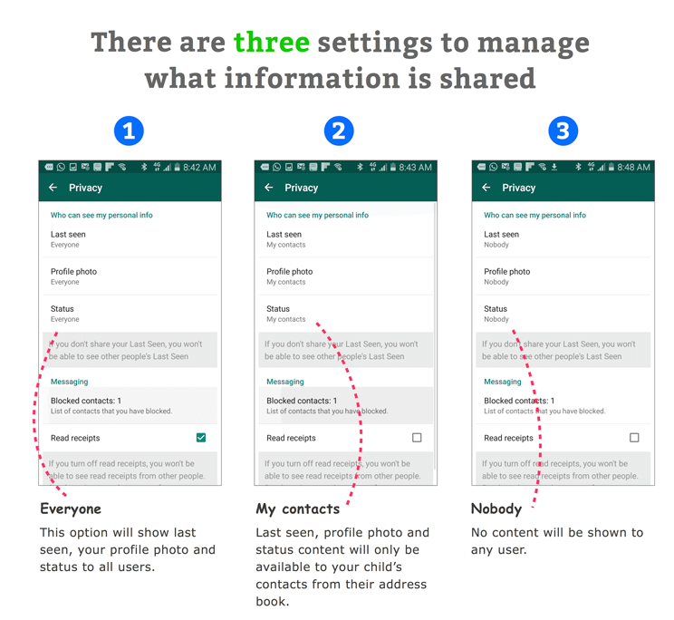

Slide 50
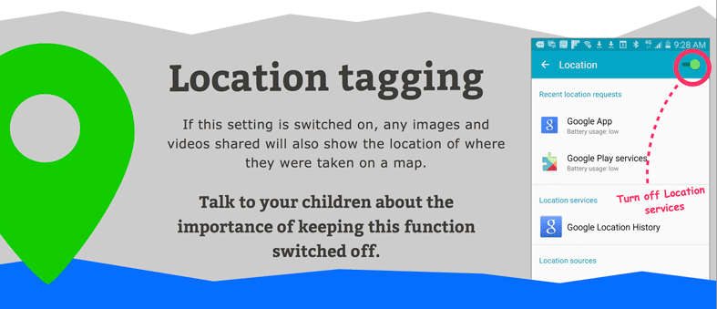

Slide 51


Slide 52
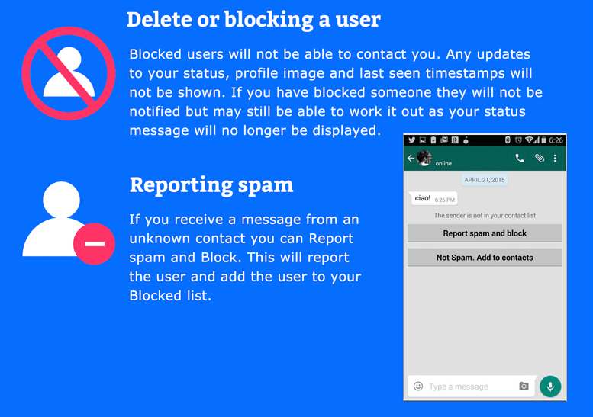

Slide 53
GAMING – social networking in games
Half of all 5-15 year olds play games online
25% of online games players aged 12-15 chat to people they don’t know
Xbox Live, PlayStation Live, Steam and Nintendo Network all have privacy settings that you can set.
Nintendo Network is the most family friendly
Best advice is to set up a master account – enter the child’s age.
INTERNET MATTERS has all the guides for setting up parental controls

Slide 54
MOBILE INTERNET
Your provider can set privacy settings for you.
Go to INTERNETMATTERS.ORG for advice.
Remember: Your child should not be on their phone in private

Slide 55
cyberbullying
Usually more prevalent at secondary school
Children need to be taught how to stay safe online and keep things private
In school’s behaviour policy – includes serious sanctions
Being honest with children about the things they say
Online reputation
Reporting it to school/platforms/police
“Don’t say anything online that your wouldn’t be happy with your teacher or grandparents reading.”

Slide 56
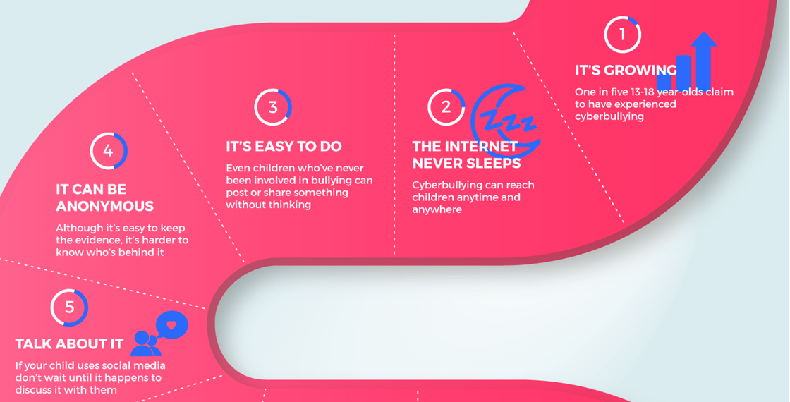

Slide 57
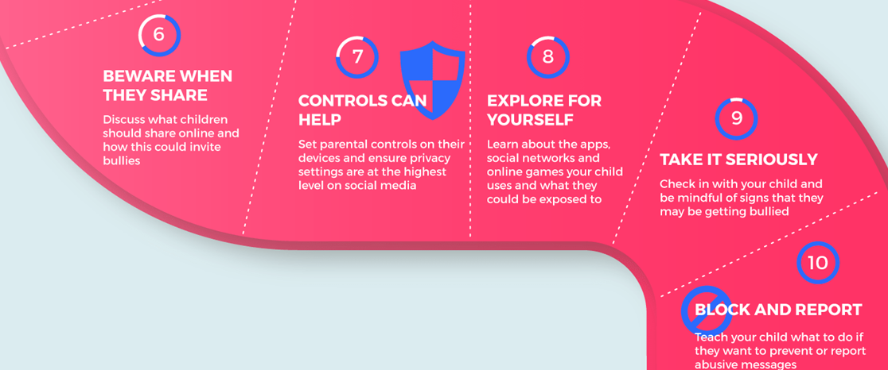

Slide 58
What next?
Go home and play with the privacy settings
Agree rules at home
Come and ask us if you are not clear about anything – though we are not experts!
Fill in the survey when it comes out after half term.
Go to www.internetmatters.org or www.saferinternet.org.uk
Most importantly, talk to your child(ren) about it.

